Slide 1

7th Grade Accelerated Math
Unit 3, Lesson 4 Negative Exponent Law Volume 1, pg. 117

Slide 2


Benchmark
MA.8.NSO.1.3
Extend previous understanding of the Laws of Exponents to include integer exponents. Apply the Laws of Exponents to evaluate numerical expressions and generate equivalent numerical expressions, limited to integer exponents and rational number bases, with procedural fluency.
volume 1, pg. 117

Slide 3
Integrated Mathematical Thinking and Reasoning Standards
MA.K12.MTR.1.1 Actively participate in effortful learning both individually and collectively.
MA.K12.MTR.2.1 Demonstrate understanding by representing problems in multiple ways.
MA.K12.MTR.3.1 Complete tasks with mathematical fluency.
MA.K12.MTR.5.1 Use patterns and structure to help understand and connect mathematical concepts.
volume 1, pg. 117

Slide 4

Learning Targets
I can apply the laws of exponents to evaluate numerical expressions with integer exponents.
I can generate equivalent numerical expressions using the laws of exponents for the expressions with integer exponents.
volume 1, pg. 117

Slide 5

Warm-Up
volume 1, pg. 118

Slide 6
3.4.1 Warm-Up: Day at Work with a Fish Biologist
Moises, an ichthyologist, or fish biologist, says, “Try to be in touch with a system that you really want to study, with a system that really drives you crazy, because that’s how you nurture passion and passion is one of the most important things in becoming a researcher.”
What is something that you are passionate about?
Why do you think he says that passion is one of the most important things in becoming a researcher?
volume 1, pg. 118

Slide 7

Collaboration
volume 1, pg. 118

Slide 8

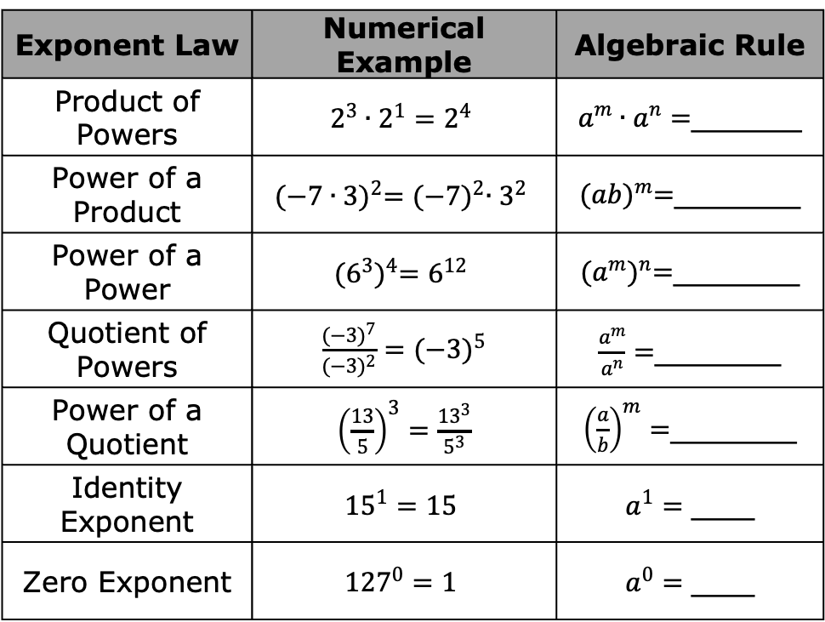
3.4.2 Collaboration: Laws of Exponents
1. Complete the rule for each exponent law shown.
Exponent Law | Numerical Example | Algebraic Rule
Product of Powers | $$2^{3}∙2^{1}=2^{4}$$ | $a^{m}∙a^{n}=$_______
Power of a Product | $${(−7∙3)}^{2}={(−7)}^{2}∙3^{2}$$ | ${(ab)}^{m}=$________
Power of a Power | $${(6^{3})}^{4}=6^{12}$$ | ${(a^{m})}^{n}=$________
Quotient of Powers | $\frac{{(−3)}^{7}}{{(−3)}^{2}}={(−3)}^{5}$ | $\frac{a^{m}}{a^{n}}=$________
Power of a Quotient | ${\left(\frac{13}{5}\right)}^{3}=\frac{{13}^{3}}{5^{3}}$ | ${\left(\frac{a}{b}\right)}^{m}=$________
Identity Exponent | $${15}^{1}=15$$ | $a^{1}=$ ____
Zero Exponent | $${127}^{0}=1$$ | $a^{0}=$ ____
volume 1, pg. 118

Slide 9
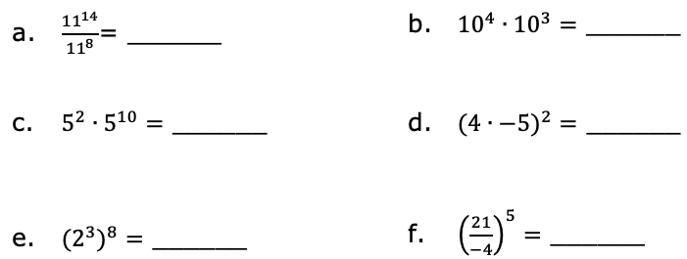
2. Write an equivalent exponential expression by applying the laws of exponents.
volume 1, pg. 118

Slide 10

Exploration
volume 1, pg. 119

Slide 11

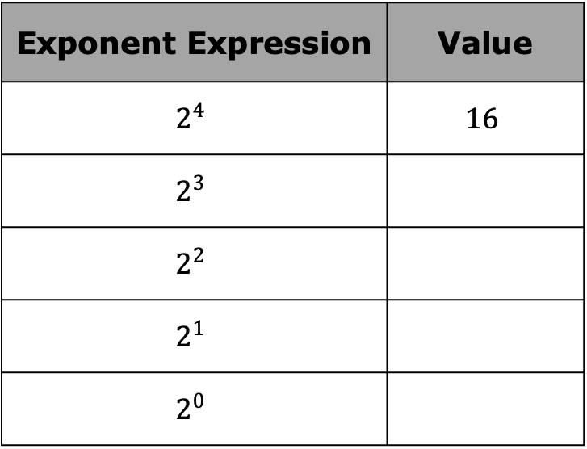
3.4.3 Exploration: Finding Patterns to Evaluate Numeric Expressions with Exponents
Work with your partner to complete the following.
Complete the table.
Exponent Expression | Value
$$2^{4}$$ | $$16$$
$$2^{3}$$
$$2^{2}$$
$$2^{1}$$
$$2^{0}$$
volume 1, pg. 119

Slide 12



Describe any mathematical pattern(s) you notice regarding how the values of the expressions change as the exponent changes.
Complete the statement.
As the exponent by 1, the value
of the expression can be found by
the previous value by
volume 1, pg. 119

Slide 13
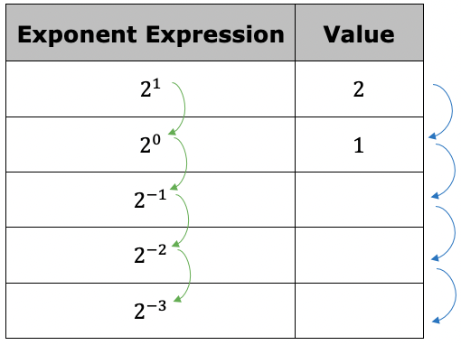
4. Continue the pattern to complete the table.
volume 1, pg. 119

Slide 14
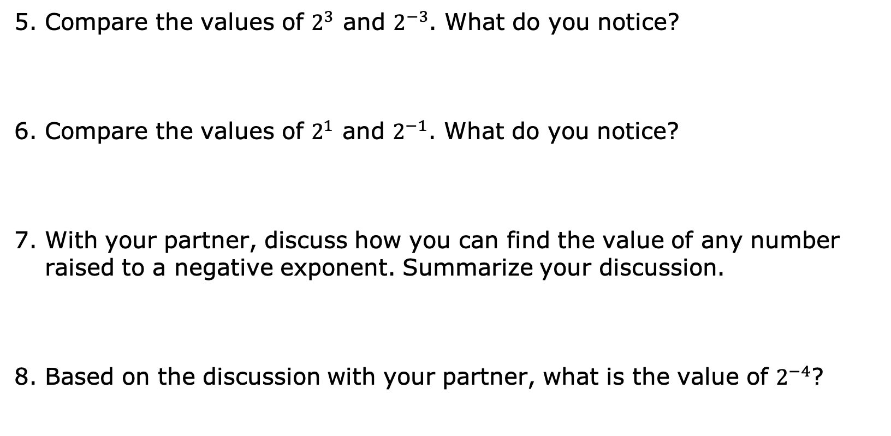
Compare the values of $2^{3}$ and $2^{−3}$. What do you notice?
Compare the values of $2^{1}$ and $2^{−1}$. What do you notice?
With your partner, discuss how you can find the value of any number raised to a negative exponent. Summarize your discussion.
Based on the discussion with your partner, what is the value of $2^{−4}$?
volume 1, pg. 119

Slide 15

Bring It Together
volume 1, pg. 120

Slide 16



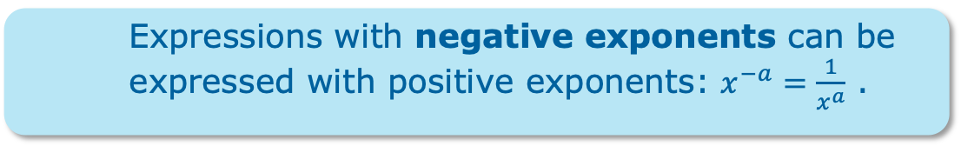
3.4.4 Bring It Together: Negative Exponents
Complete the statement.
A base with a negative exponent can be rewritten
using the of the base with the
exponent.
Expressions with negative exponents can be expressed with positive exponents: $x^{−a}=\frac{1}{x^{a}}$ .
volume 1, pg. 120

Slide 17
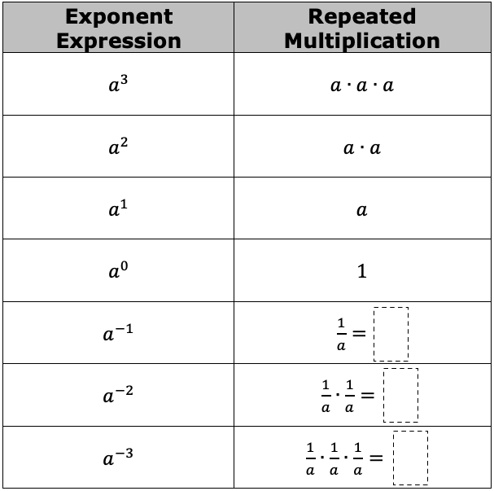
Complete the table.
volume 1, pg. 120

Slide 18

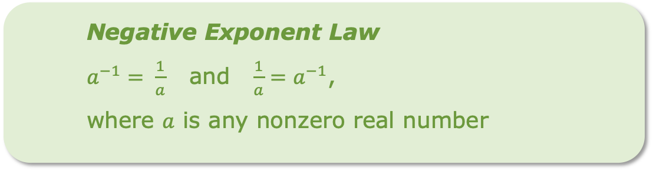
Negative Exponent Law
$a^{−1}= \frac{1}{a}$ and $\frac{1}{a}=a^{−1}$,
where $a$ is any nonzero real number
volume 1, pg. 120

Slide 19

Guided Practice
volume 1, pg. 121

Slide 20

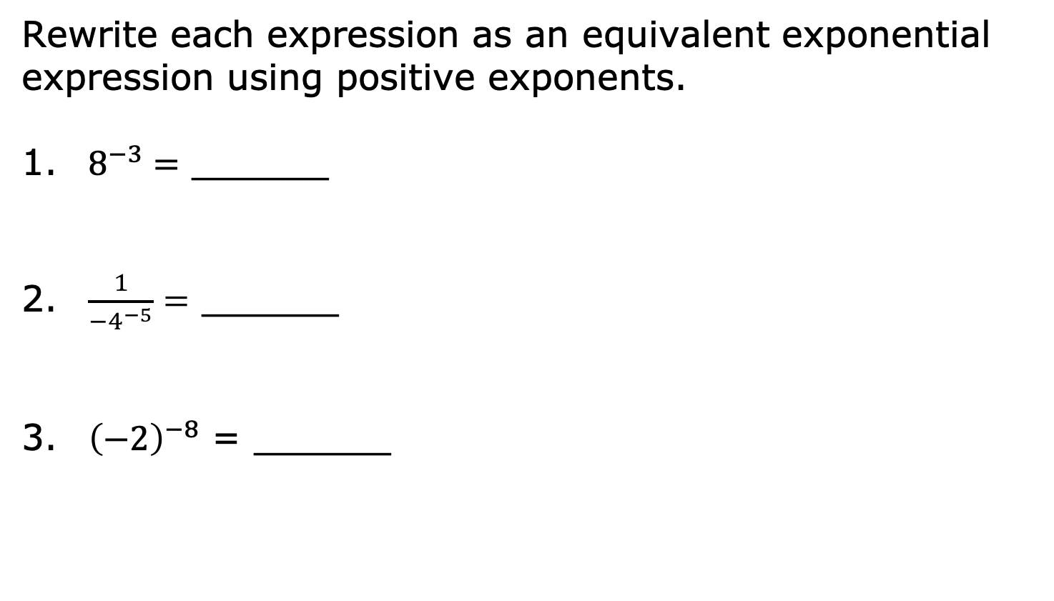
3.4.5 Guided Practice: Rewriting Negative Exponents
Rewrite each expression as an equivalent exponential expression using positive exponents.
$8^{−3}=$ ______
$\frac{1}{{−4}^{−5}}=$ ______
${\left(−2\right)}^{−8}$ = ______
volume 1, pg. 121

Slide 21

$\frac{1}{{10}^{−2}}=_________$
$−5∙6^{−4}$= _______
$\frac{2^{−3}}{9^{−2}}=$ ______
volume 1, pg. 121

Slide 22
Collaboration
volume 1, pg. 121

Slide 23
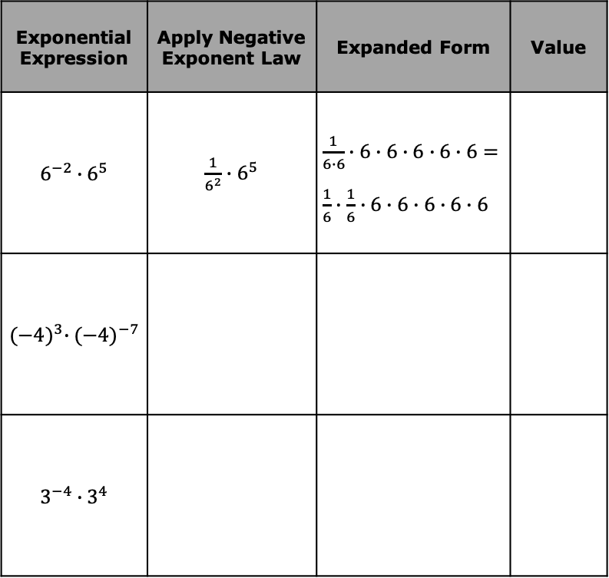
3.4.6 Collaboration: Applying Other Exponent Laws with Negative Exponents
Work with your partner to complete the following.
Consider the exponential expressions in the table.
For each expression, work with your partner to rewrite the exponential expression in expanded form and evaluate. The first row has been partially completed.
Exponential Expression | Apply Negative Exponent Law | Expanded Form | Value
$$6^{−2}∙6^{5}$$ | $\frac{1}{6^{2}}∙6^{5}$ | $\frac{1}{6∙6}∙6∙6∙6∙6∙6=\frac{1}{6}∙\frac{1}{6}∙6∙6∙6∙6∙6$
$${(−4)}^{3}∙{(−4)}^{−7}$$
$$3^{−4}∙3^{4}$$
volume 1, pg. 121

Slide 24
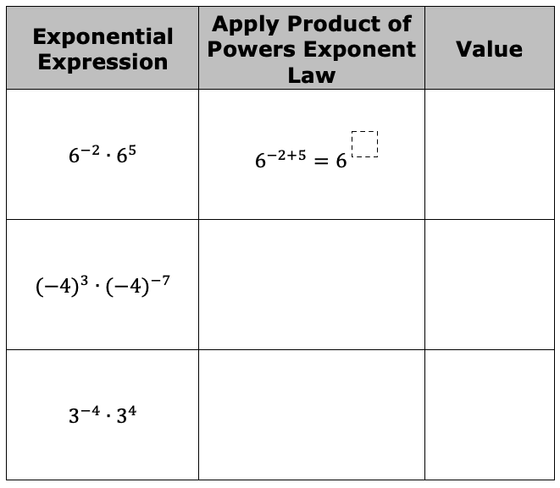
Complete the table to evaluate each expression by applying the product of powers law.
With your partner, discuss your observations of the tables from Parts A and B.
volume 1, pg. 122

Slide 25
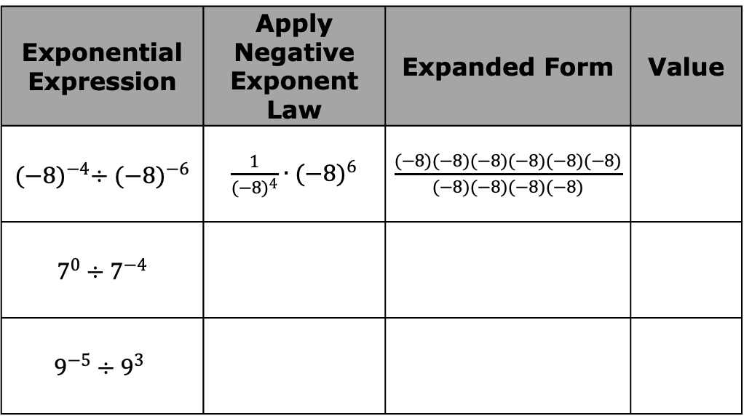
2. Consider the exponential expressions in the table.
For each expression, work with your partner to rewrite the exponential expression in expanded form and evaluate. The first row has been partially completed.
Exponential Expression | Apply Negative Exponent Law | Expanded Form | Value
${(−8)}^{−4}÷{(−8)}^{−6}$ | $\frac{1}{{(−8)}^{4}}∙{(−8)}^{6}$ | $\frac{(−8)(−8)(−8)(−8)(−8)(−8)}{(−8)(−8)(−8)(−8)}$
$7^{0}÷7^{−4}$
$$9^{−5}÷9^{3}$$
volume 1, pg. 122

Slide 26
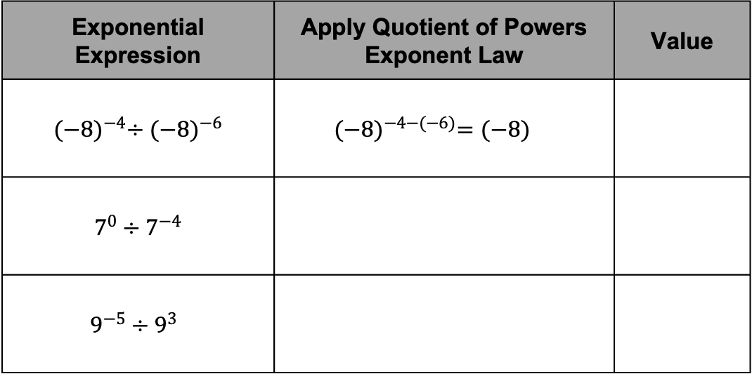
Complete the table to evaluate each expression by applying quotient of powers law.
With your partner, discuss your observations of the tables after completing Parts A and B.
Exponential Expression | Apply Quotient of Powers Exponent Law | Value
${(−8)}^{−4}÷{(−8)}^{−6}$ | ${(−8)}^{−4−(−6)}={(−8)}^{ }$
$7^{0}÷7^{−4}$
$$9^{−5}÷9^{3}$$
volume 1, pg. 122

Slide 27

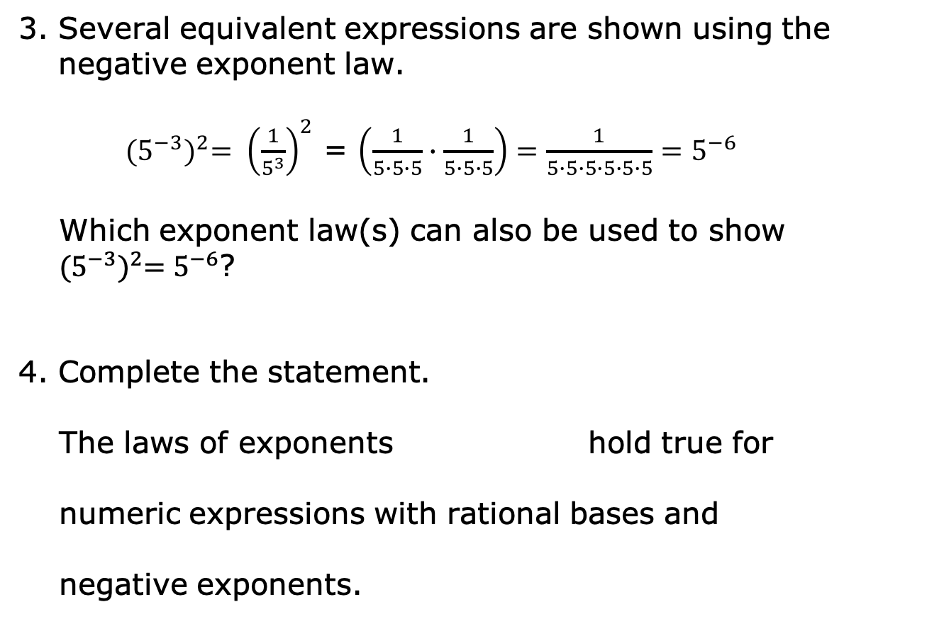
Several equivalent expressions are shown using the negative exponent law.
${(5^{−3})}^{2}= {\left(\frac{1}{5^{3}}\right)}^{2}$ = $\left(\frac{1}{5∙5∙5}∙\frac{1}{5∙5∙5}\right)=\frac{1}{5∙5∙5∙5∙5∙5}=5^{−6}$
Which exponent law(s) can also be used to show
${(5^{−3})}^{2}=5^{−6}$?
Complete the statement.
The laws of exponents hold true for
numeric expressions with rational bases and
negative exponents.
volume 1, pg. 123

Slide 28

Wrap-Up
volume 1, pg. 123

Slide 29

3.4.7 Wrap-Up: Cool Down
volume 1, pg. 123

